Slide 1
Blood Safety and Availability
Application
GROUP : Stuck Overflow
Snehal Patel - 001021675
Marisa Thomas - 001020479
Shravani Vaze - 001375943

Slide 2
Objective
To design, develop and implement a blood safety and availability system, which will enable real time access to availability of blood bags at state - level and proper accounting of blood donors, thus ensuring fast, safe and secure blood transfusion services.

Slide 3
Problem Statement
The general case scenario in hospitals today is that , if a patient requires a particular type of blood , which is not available in that hospital, then they end up requesting friends and family members in order to search for a match.
This is very time consuming and risky in case of a life and death situation.

Slide 4
Solution
A one stop application that keeps track of blood bags availability and donors across the state.
This will help avoid shortage of a particular blood type and the blood donor’s registration will ensure that blood transfusion services will be safe and secure.
Such an application will benefit doctors, nurses and patients ensuring a more efficient health care system.

Slide 5
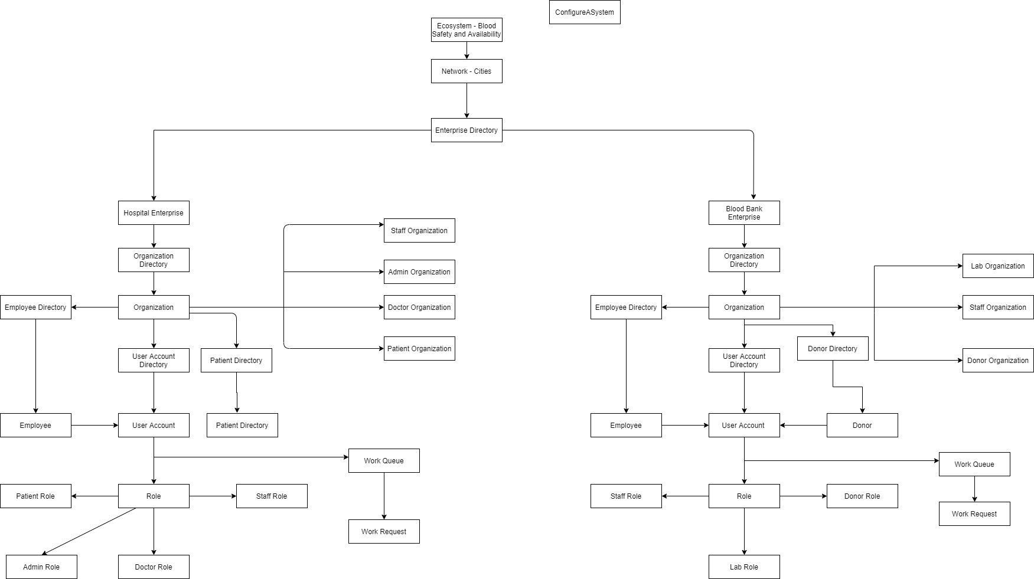
Eco-System Architecture Diagram

Slide 6
UML Diagram
Blood Safety and Availability UML Diagram

Slide 7
Work Flow
Blood Safety and Availability Work Flow

Slide 8
Roles and Capability
Sysadmin : Manages the network(cities),Manages the enterprise for hospital and blood bank, creates hospital and blood bank admin
Blood bank admin : Manages blood bank organization(blood bank staff, lab supervisor, donor), Manages blood bank employees
Donor : Registers himself(personal details), change his login password
Blood bank Staff : Can view the donor registrations, and responsible for checking if donor is eligible to donate blood and assigning responsible lab supervisor, can update login password, checks requests for blood from hospitals.
Lab supervisor : view details of assigned donors, responsible for the blood extraction and processing of blood , can update his login credentials

Slide 9
Roles and Capability
Hospital admin : Manages hospital organization(Doctor , Patient, Hospital staff),manages hospital employees , manages patients
Patient : Can register at the hospital, change login credentials , view patient history
Hospital Staff : Can view admitted patients , check patients vitals and assigns doctor, check requests for transfusion and process the request( searches for blood type availability at blood bank and places order , can change his login credentials
Doctor : Can view assigned patients and performs diagnosis and places requests for blood transfusion, can update his login credentials

Slide 10
References
https://www.redcrossblood.org/
https://www.oneblood.org/about-donating/target-your-type/

